Slide 1
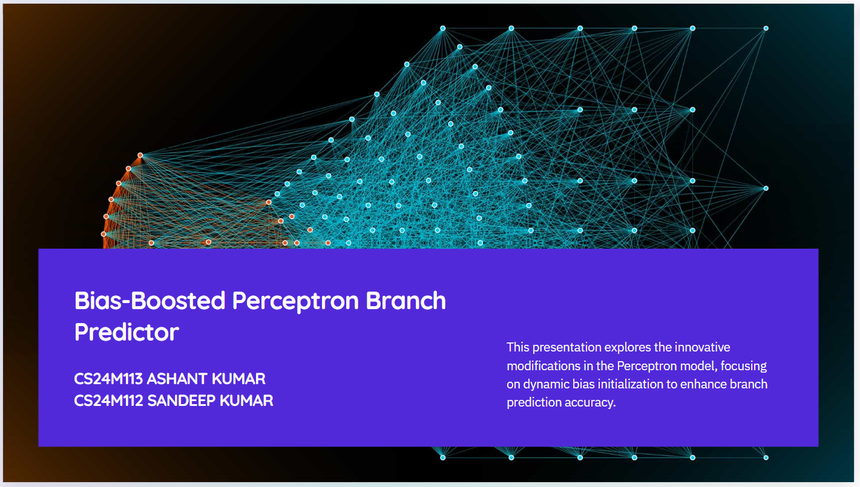

Slide 2
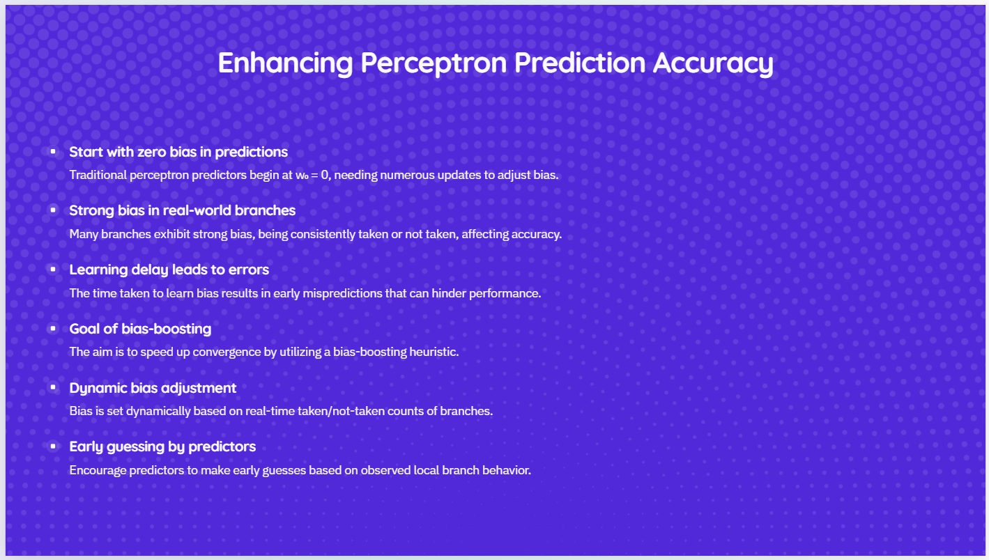

Slide 3
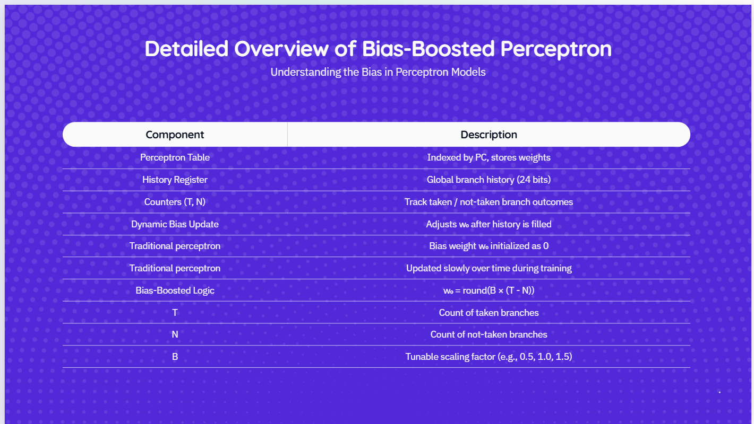
Lightweight & Easily Integrates with Standard Perceptron Logic

Slide 4
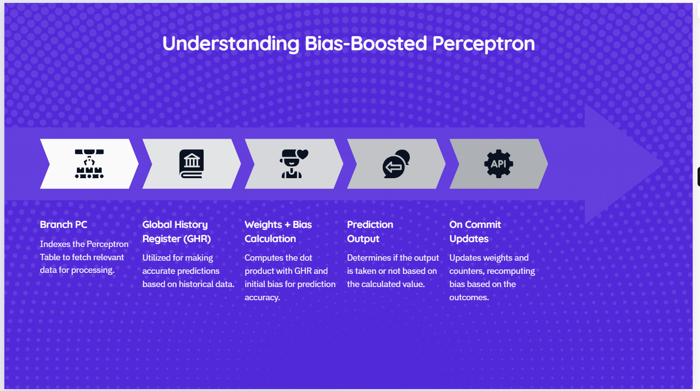
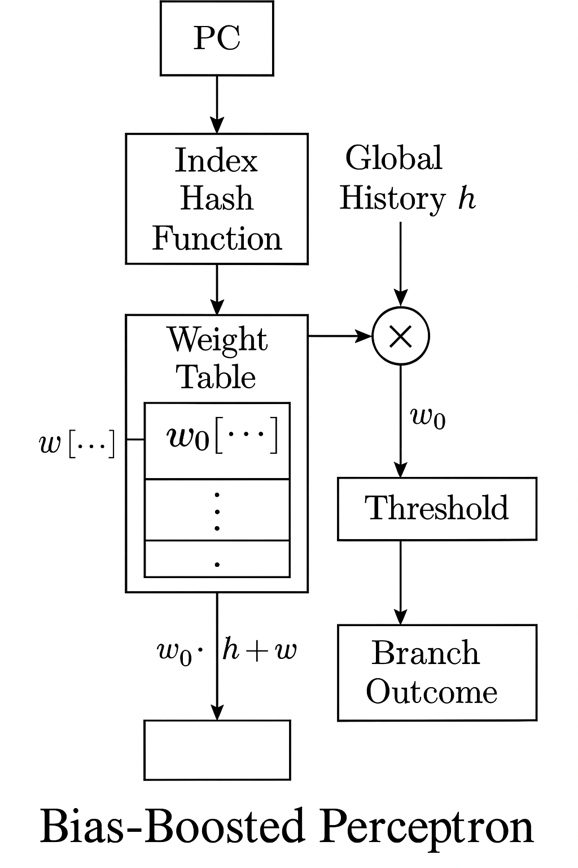
Faster convergence toward biased branch behavior, improving accuracy in longer traces

Slide 5
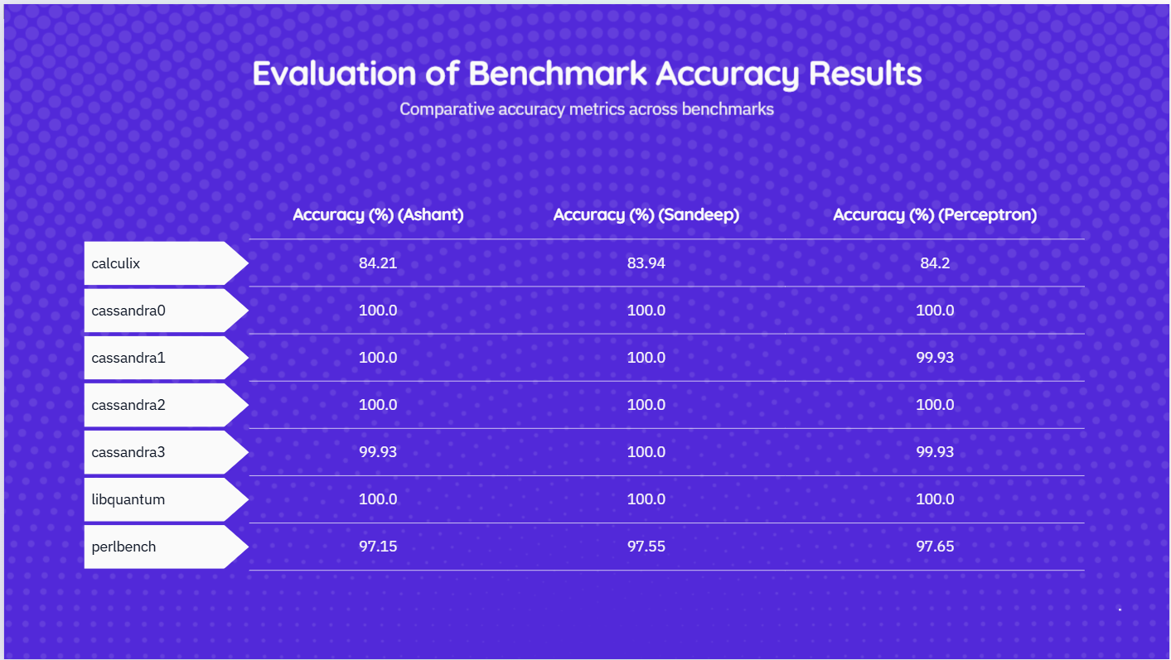

Slide 6

Evaluation and Results Comparison
Metric | Observation
IPC | Identical to Perceptron
Branch Accuracy | Slight gain (e.g., in calculix)
Bias Logic | Uses w₀ = B × (T - N) heuristic
L1D Miss Rate | Marginal improvement in some traces
Overhead | Negligible
A safe, low-overhead enhancement with minor but consistent benefits

Slide 7
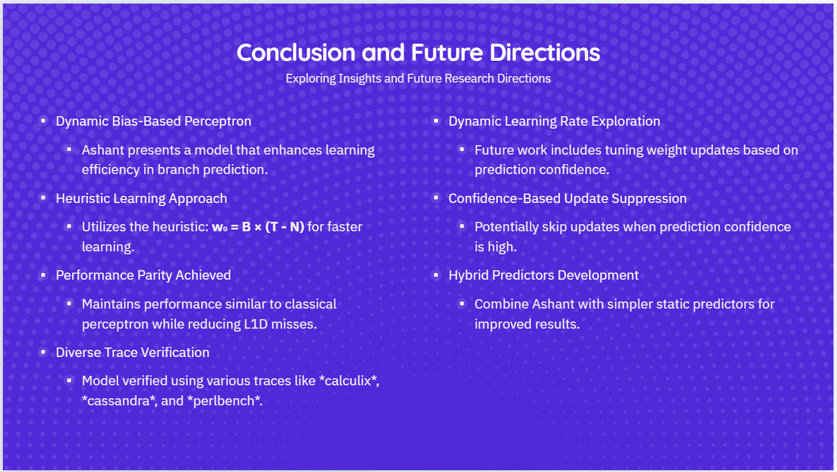

Slide 8

Conclusion
It introduces a dynamic bias-based perceptron model.
Learns branch behavior faster using heuristic: w₀ = B × (T - N).
Maintains performance parity with classical perceptron while reducing L1D misses in select cases.
Verified across diverse traces including calculix, cassandra, and perlbench.
Future Work
Dynamic Learning Rate:
Tune weight updates based on prediction confidence.
Confidence-Based Suppression:
Skip updates when prediction confidence is high.
Hybrid Predictors:
Combine Ashant with simpler static predictors.
Visualization:
Add runtime monitoring of predictor confidence and bias evolution.

Slide 9
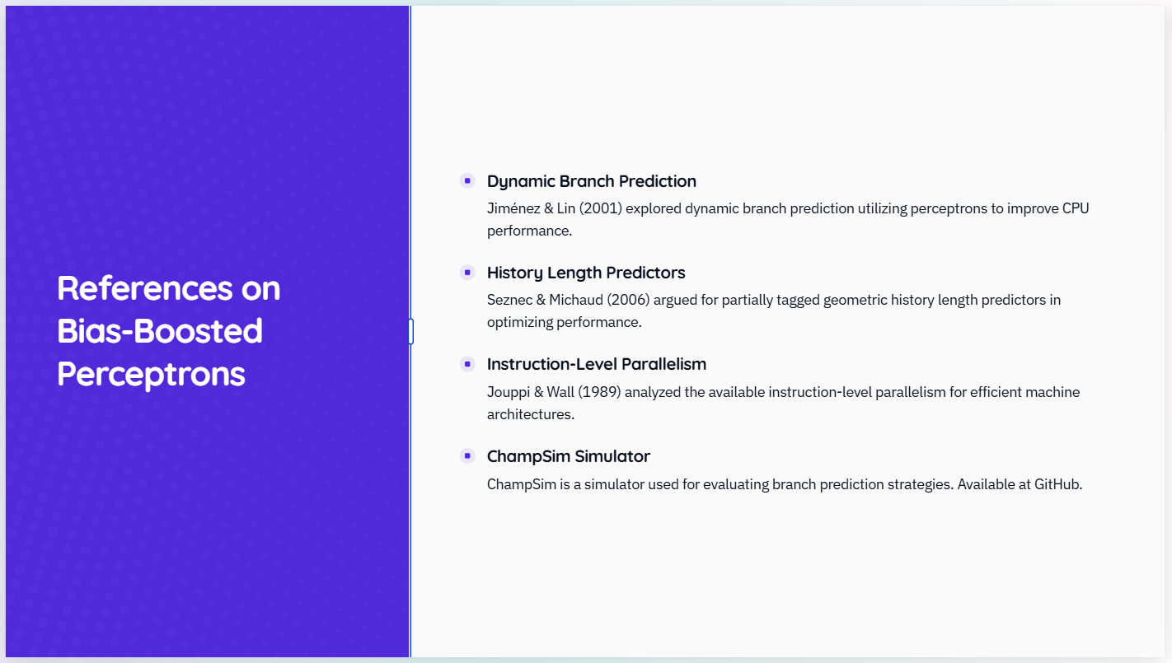

Slide 10

Thank You

